Slide 1
Software Development Life Cycle Models-
Waterfall model
vs
Agile model

Slide 2
WHY DEVOPS?

Slide 3
Software Development
DEVELOPMENT TEAM
OPERATIONS TEAM
plan
design
- build
test
implement
- feedback

Slide 4
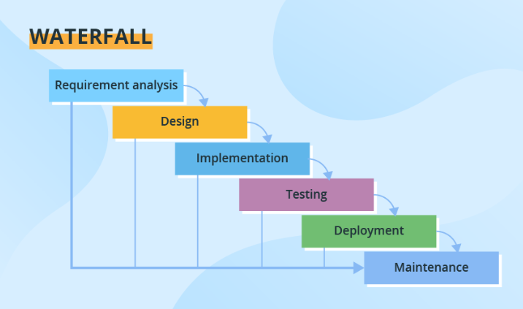
Software Development Life Cycle Models-
Waterfall model

Slide 5
Software Development Life Cycle Models-
Waterfall model-
ADVANTAGES-
Simple
Follows a straight-forward approach
DISADVANTAGES-
Unless you complete a particular stage, you cannot proceed to the next stage
Time consuming
Suitable only for stable applications.
Cannot be used used for large and object-oriented applications.

Slide 6
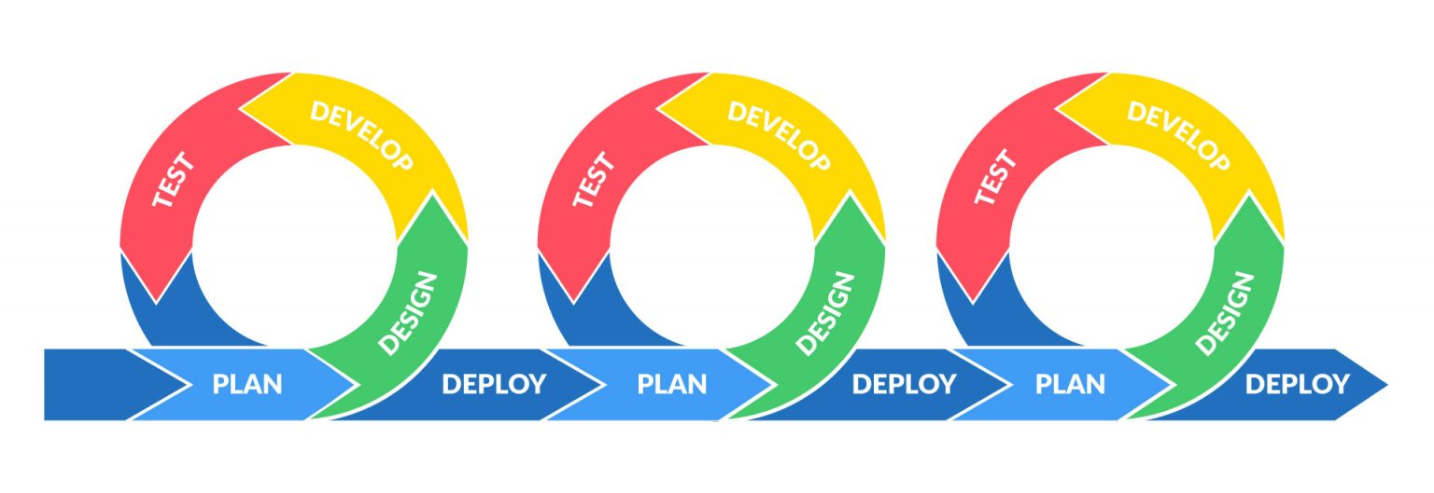
Software Development Life Cycle Models-
Agile methodology
Agile is a project management approach that emphasizes collaboration, flexibility, and customer satisfaction. It values delivering a working product incrementally and embracing change.

Slide 7
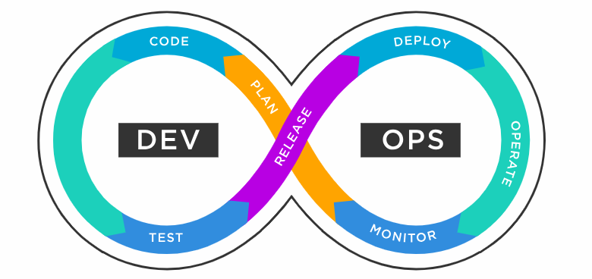
A DevOps pipeline is the set of tools, flows, and automated processes that enable teams to effectively and efficiently leverage various technologies in building and deploying software.
→The primary objective of the pipeline is to keep the software development process well focused and continually organized.

Slide 8
DevOps, a combination of ‘development and operations’, is a mix of practices, tools and cultural philosophies that enable an organization to quickly deliver applications and services. It also helps products go from the drawing board to market at a faster pace than traditional software development because operations and development engineers work closely together in the entire lifecycle, from design through the development process to production support.
Generally, DevOps represents a change in the culture of IT from one of separateness to one of working as a team. It’s about creating rapid service delivery using Agile, lean practices in a system-oriented approach. DevOps also aims to use technology, especially automation tools, to leverage highly programmable and dynamic infrastructure.
Various DevOps tools such as Git, Ansible, Docker, Puppet, Jenkins, Chef, Nagios, and Kubernetes.

Slide 9
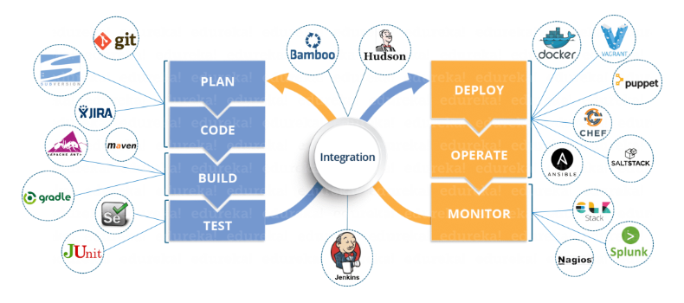
DevOps Architecture

Slide 10
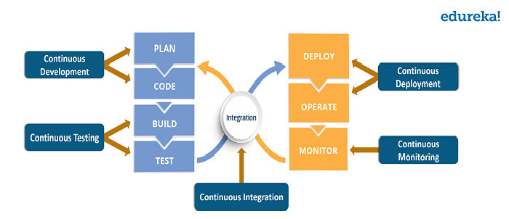
DevOps Lifecycle
The various phases such as continuous development, continuous integration, continuous testing, continuous deployment, and continuous monitoring constitute DevOps Life cycle. Now let us have a look at each of the phases of DevOps life cycle one by one.

Slide 11
SOURCE CODE MANAGEMENT
GIT
- A high quality distributed version control system that lets us manage and keep track of source code.
Installed and managed on our local systems rather than on the cloud
GITHUB
A hosting service for managing our git repositories
Exclusively cloud-based

Slide 12

SOURCE CODE MANAGEMENT
Version Control System
Version Control or Source Control is the practice of tracking and managing changes to the source code.
Version Control Systems(VCS) are software tools that helps software teams manage changes to source code over time.

Slide 13
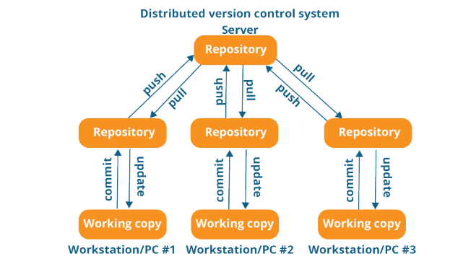
SOURCE CODE MANAGEMENT
Distributed Version Control System [GIT]
→ Peer to peer approach

Slide 14
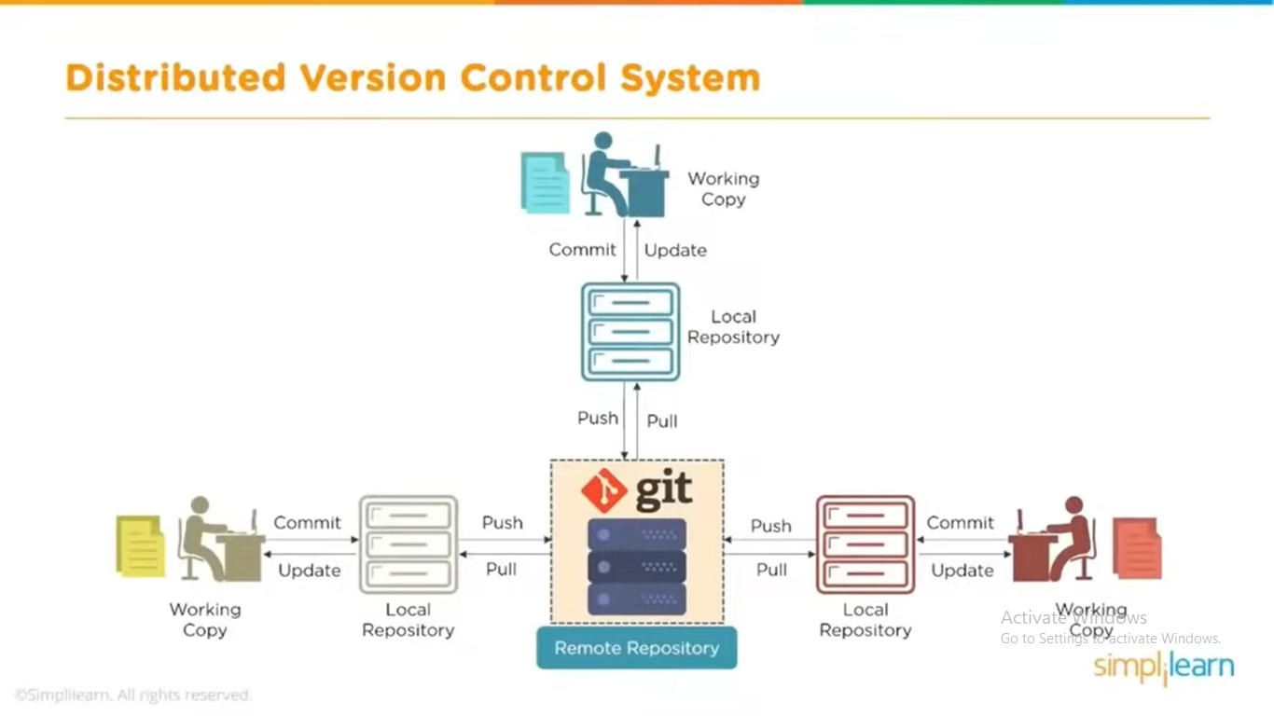
SOURCE CODE MANAGEMENT
Distributed Version Control System [GIT]

Slide 15
SOURCE CODE MANAGEMENT
GIT | GITHUB
1. A Distributed VCS | 1. A remote server for source code repository
2. A software tool | 2. A service
2. Installed on our local system | 2. Hosted on the web
3. Used to manage versions of source code | 3. Used to have a copy of the local repository code stored on the website
4. Uses command line to interact with files | 4. Provides a graphical interface to store files

Slide 16
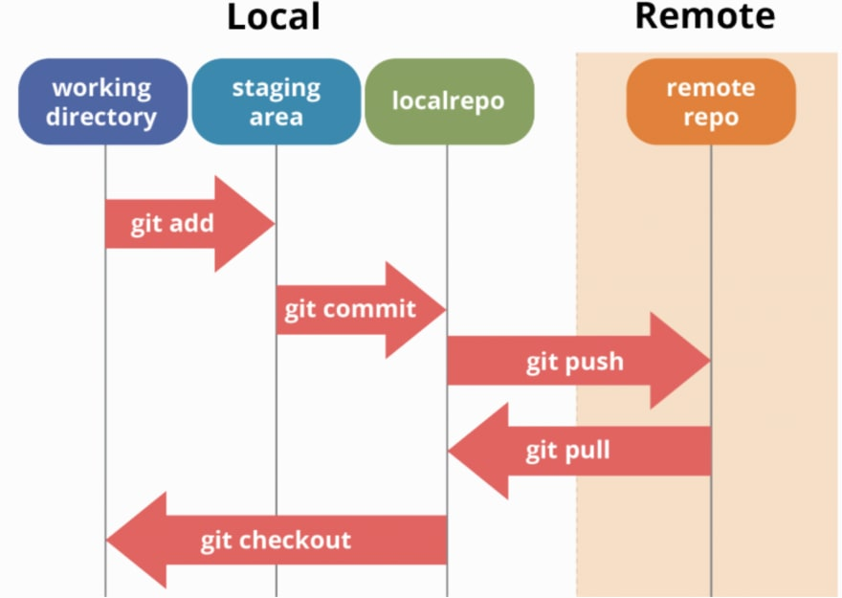
GIT workflow

Slide 17
GIT Repositories
While working on Git, we actively use two repositories.
Local repository: The local repository is present on our computer and consists of all the files and folders. This Repository is used to make changes locally, review history, and commit when offline.
Remote repository: The remote repository refers to the server repository that may be present anywhere. This repository is used by all the team members to exchange the changes made.
Both repositories have their own set of commands. There are separate Git Commands that work on different types of repositories.

Slide 18
GIT Commands: Working with Local Repositories
1. git init
→The command git init is used to create an empty Git repository.
→After the git init command is used, a .git folder is created in the directory with some subdirectories. Once the repository is initialized, the process of creating other files begins.
2. git add
→Add command is used after checking the status of the files, to add those files to the staging area.
Before running the commit command, "git add" is used to add any new or modified files.
3. git commit
→The commit command makes sure that the changes are saved to the local repository.
→ The command "git commit –m <message>" allows you to describe everyone and help them understand what has happened.
4. git status
→ The git status command tells the current state of the repository.
→ The command provides the current working branch. If the files are in the staging area, but not committed, it will be shown by the git status. Also, if there are no changes, it will show the message no changes to commit, working directory clean.

Slide 19
GIT Commands: Working with Local Repositories
5. git config
→The git config command is used initially to configure the user.name and user.email. This specifies what email id and username will be used from a local repository.
When git config is used with --global flag, it writes the settings to all repositories on the computer.
git config --global user.name “any user name”
git config --global user.email <email id>
6. git branch
The git branch command is used to determine what branch the local repository is on.
The command enables adding and deleting a branch.
# Create a new branch git branch <branch_name>
# List all remote or local branches git branch –a
# Delete a branch git branch -d <branch_name>

Slide 20
GIT Commands: Working with Local Repositories
7. git checkout
The git checkout command is used to switch branches, whenever the work is to be started on a different branch.
The command works on three separate entities: files, commits, and branches.
# Checkout an existing branch git checkout <branch_name>
# Checkout and create a new branch with that name git checkout -b <new_branch>
8. git merge
→ The git merge command is used to integrate the branches together.The command combines the changes from one branch to another branch.
→ It is used to merge the changes in the staging branch to the stable branch.
git merge <branch_name>
9. git log
The git log command shows the order of the commit history for a repository.
The command helps in understanding the state of the current branch by showing the commits that lead to this state.
git log

Slide 21
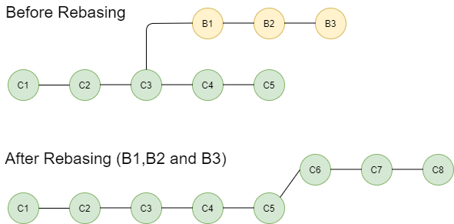
GIT Commands: Working with Local Repositories
10. git rebase
→ The git rebase is a process of integrating a series of commits on top of another base tip. It takes all the commits of a branch and appends them to the commits of a new branch.
→git rebasing looks as follows:
git rebase <branchname>

Slide 22
GIT Commands: Working with Local Repositories
11. git stash
The git stash command takes your modified tracked files and saves it on a pile of incomplete changes that you can reapply at any time. To go back to work, you can use the stash apply.
The git stash command will help a developer switch branches to work on something else without committing to incomplete work.
# Store current work with untracked files
git stash
# Bring stashed work back to the working directory
git stash apply

Slide 23
GIT Commands: Working with Remote Repositories
1. git remote
→ The git remote command is used to create, view, and delete connections to other repositories.
The connections here are not like direct links into other repositories, but as bookmarks that serve as convenient names to be used as a reference.
git remote add origin <address>
2. git push
→ The command git push is used to transfer the commits or pushing the content from the local repository to the remote repository.
The command is used after a local repository has been modified, and the modifications are to be shared with the remote team members.
git push -u origin master
3. git clone
→ The git clone command is used to create a local working copy of an existing remote repository.
→ The command downloads the remote repository to the computer. It is equivalent to the git init command when working with a remote repository.
git clone <remote_URL>

Slide 24
GIT Commands: Working with Remote Repositories
4. git pull
The git pull command is used to fetch and merge changes from the remote repository to the local repository.
The command "git pull origin master" copies all the files from the master branch of the remote repository to the local repository.
git pull <branch_name> <remote URL>

